Slide 1
Chukchi Survey Planning: Updated Plots
25 January 2022

Slide 2
Survey Types:
Simple Random
Systematic
STRS
Slides 12-14
Total Sampling Effort
Gear Types
VAST Fits
Slides 3-8
Simulate Densities
Slides 9-11
Simulate Surveys
Slide 15
Species Set
Survey Performance
Slides 16-17

Slide 3
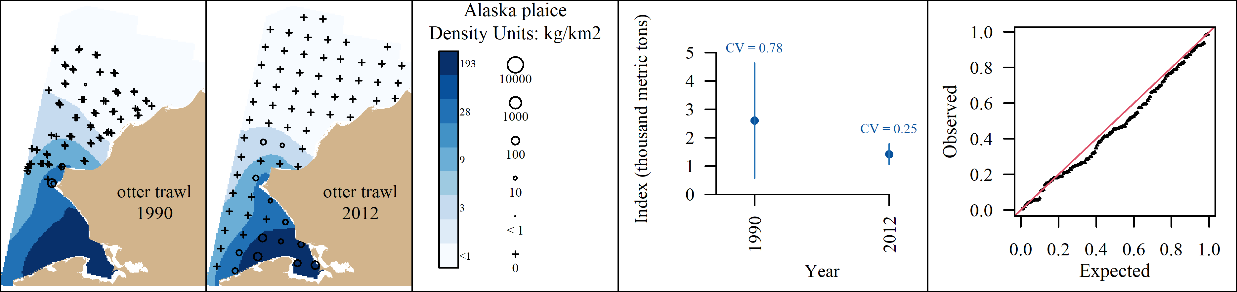

Slide 4
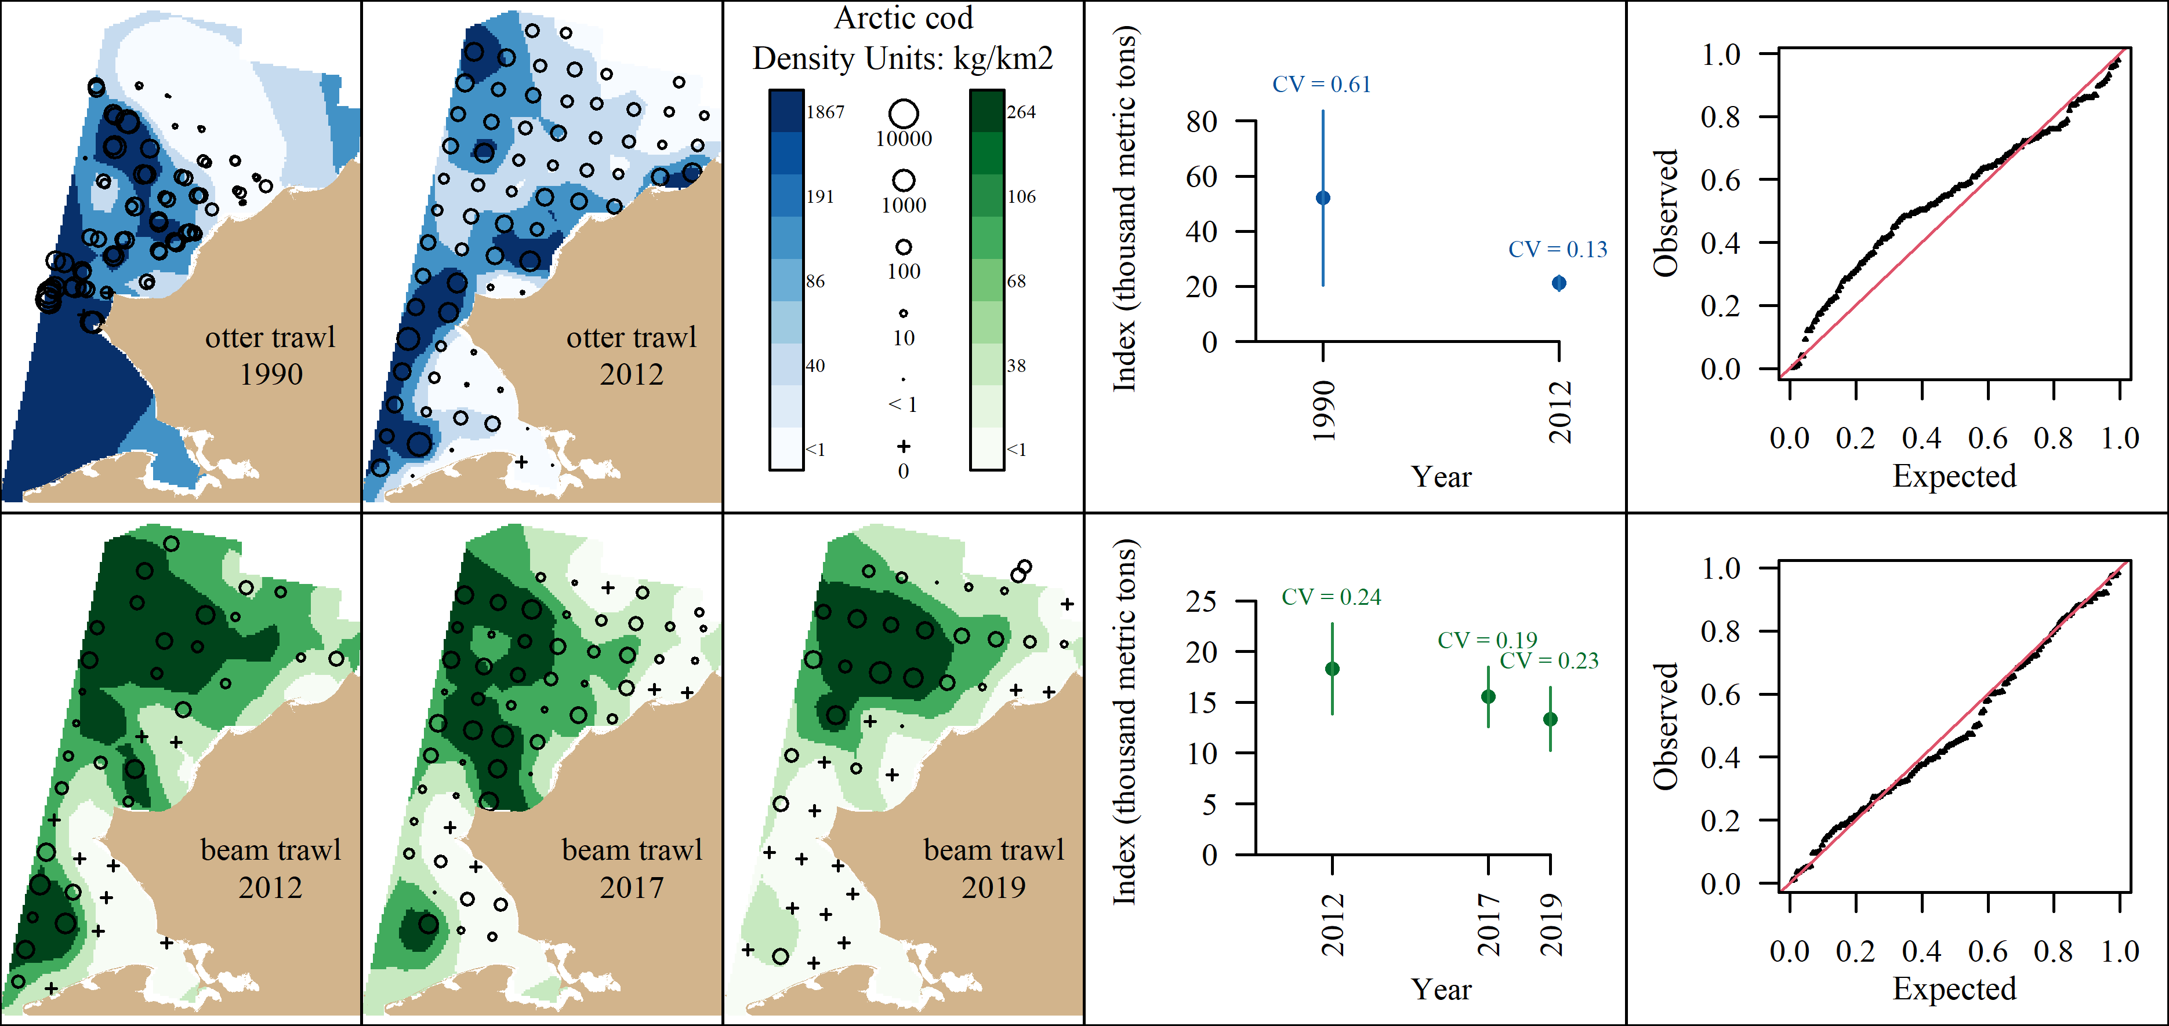

Slide 5
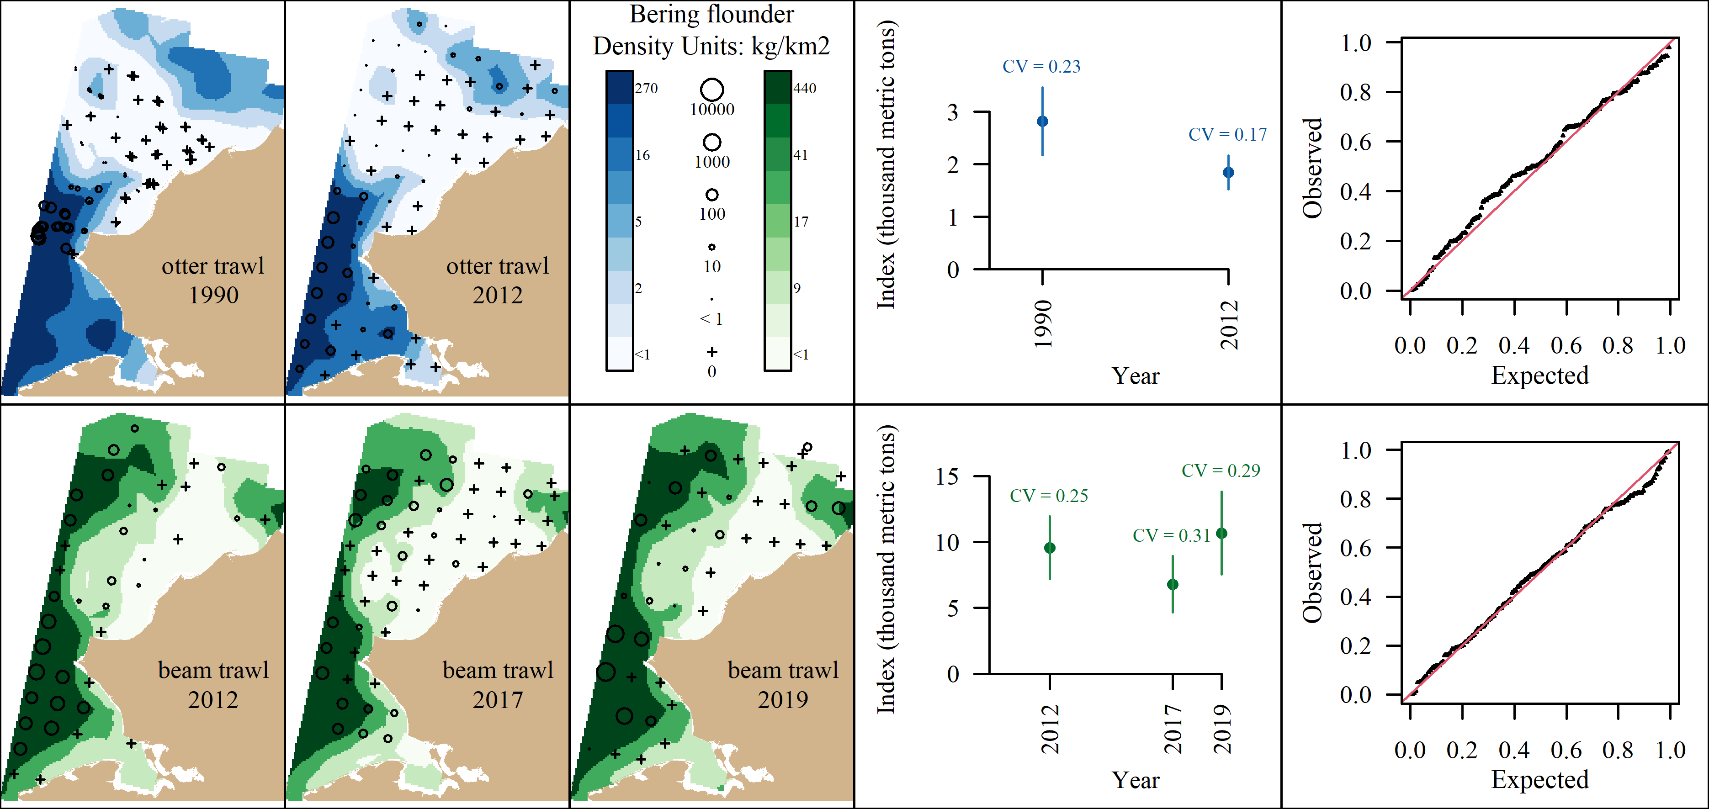

Slide 6
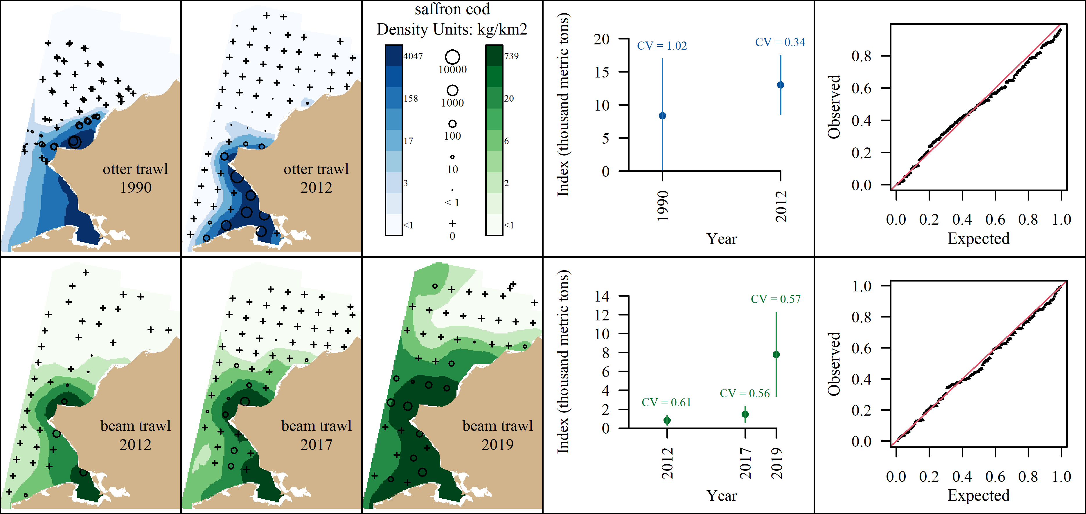

Slide 7
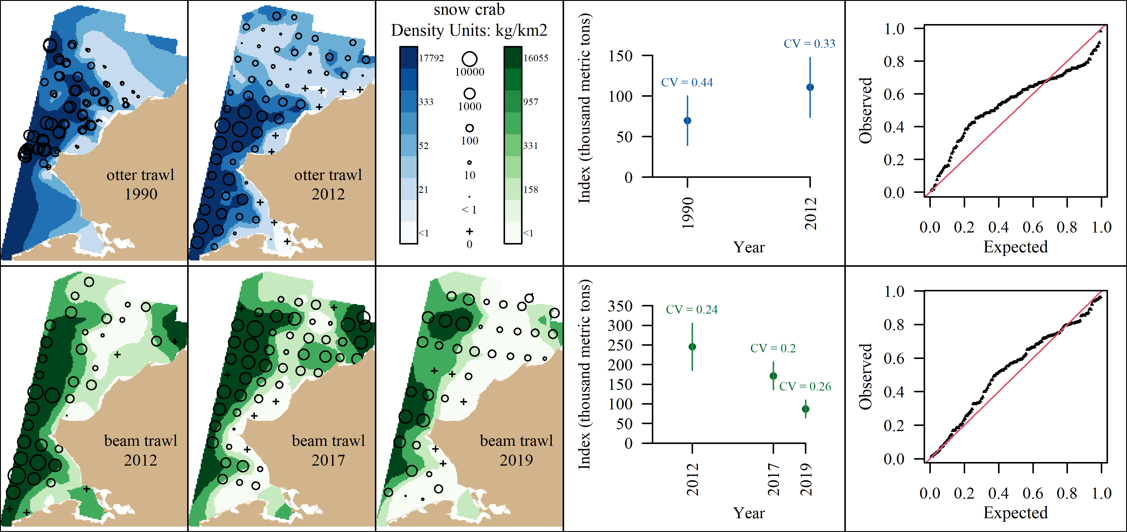

Slide 8
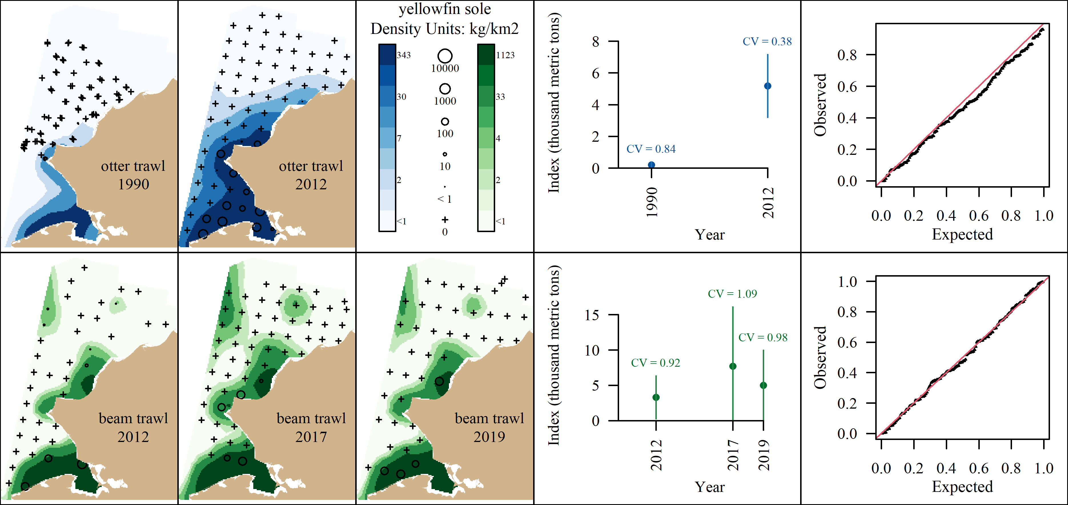

Slide 9
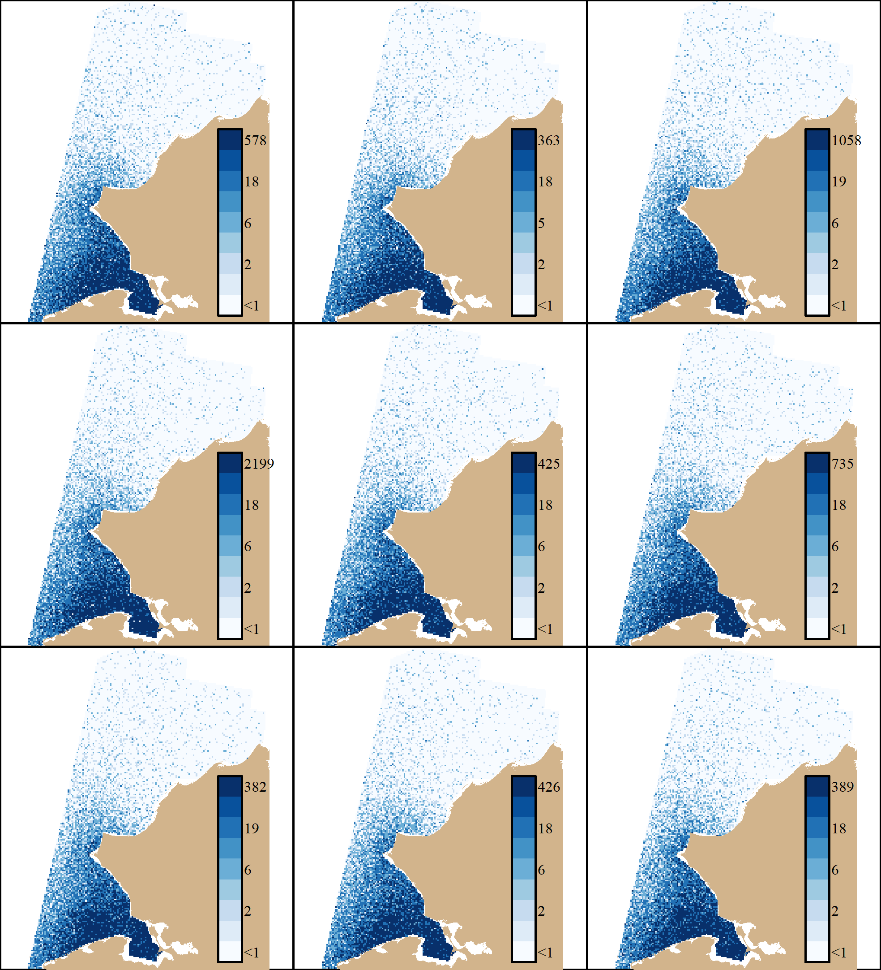
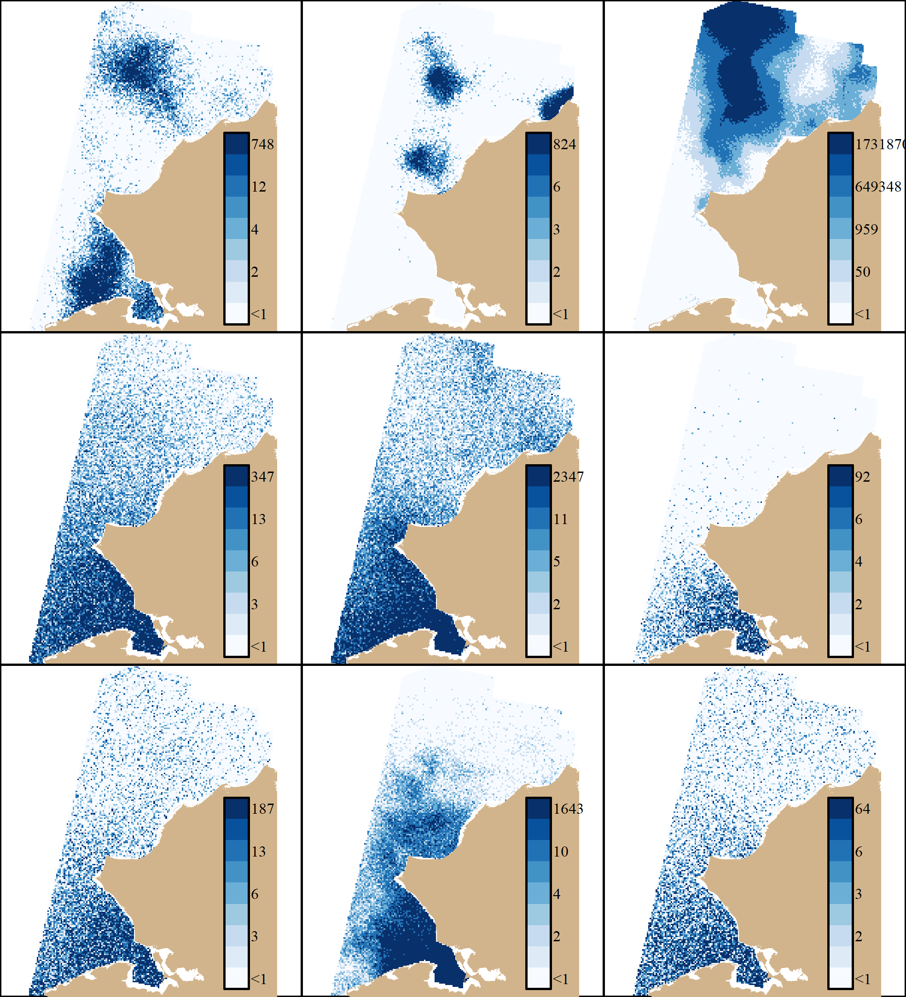
Alaska Plaice
Sim 1 (Measurement Error)
Sim 3 (Random and Fixed)

Slide 10
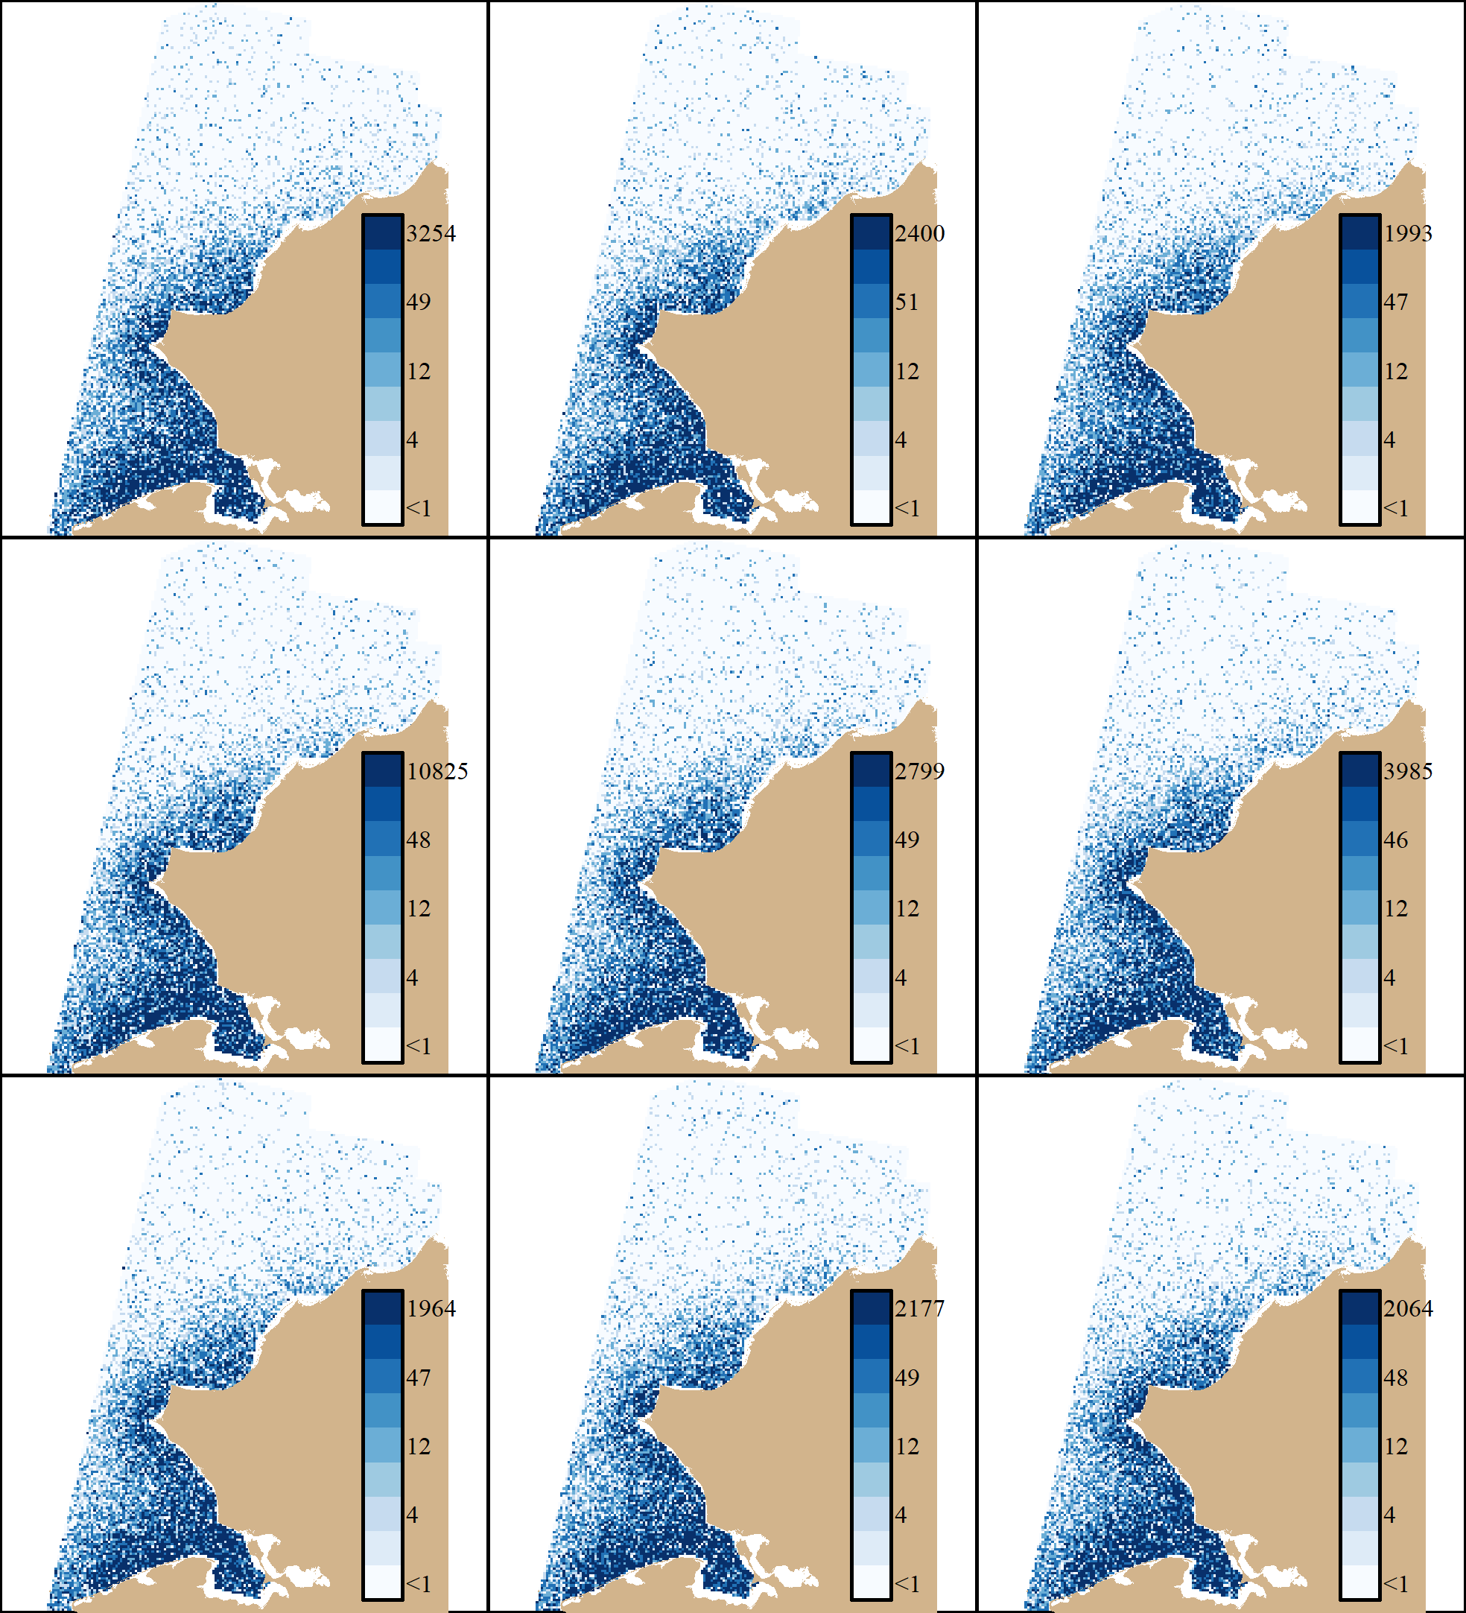
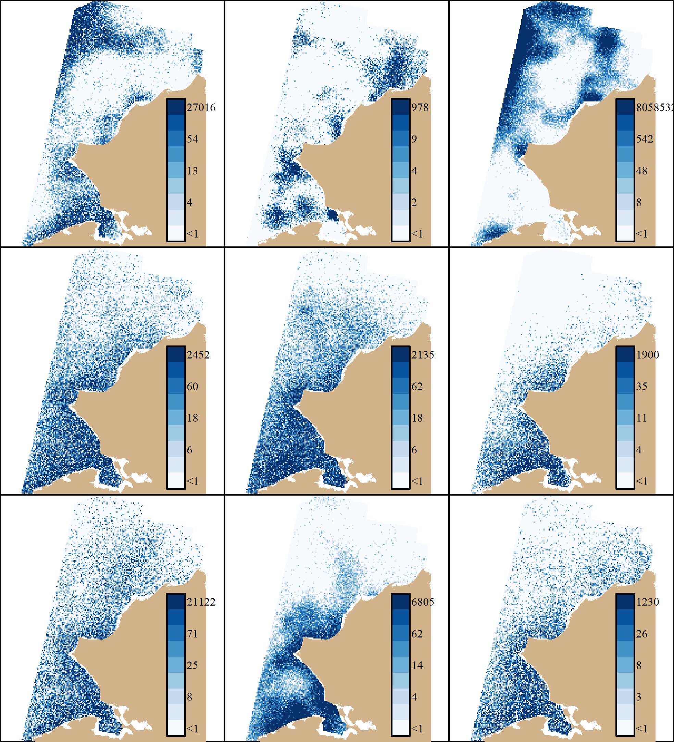
YFS
Sim 1 (Measurement Error)
Sim 3 (Random and Fixed)

Slide 11
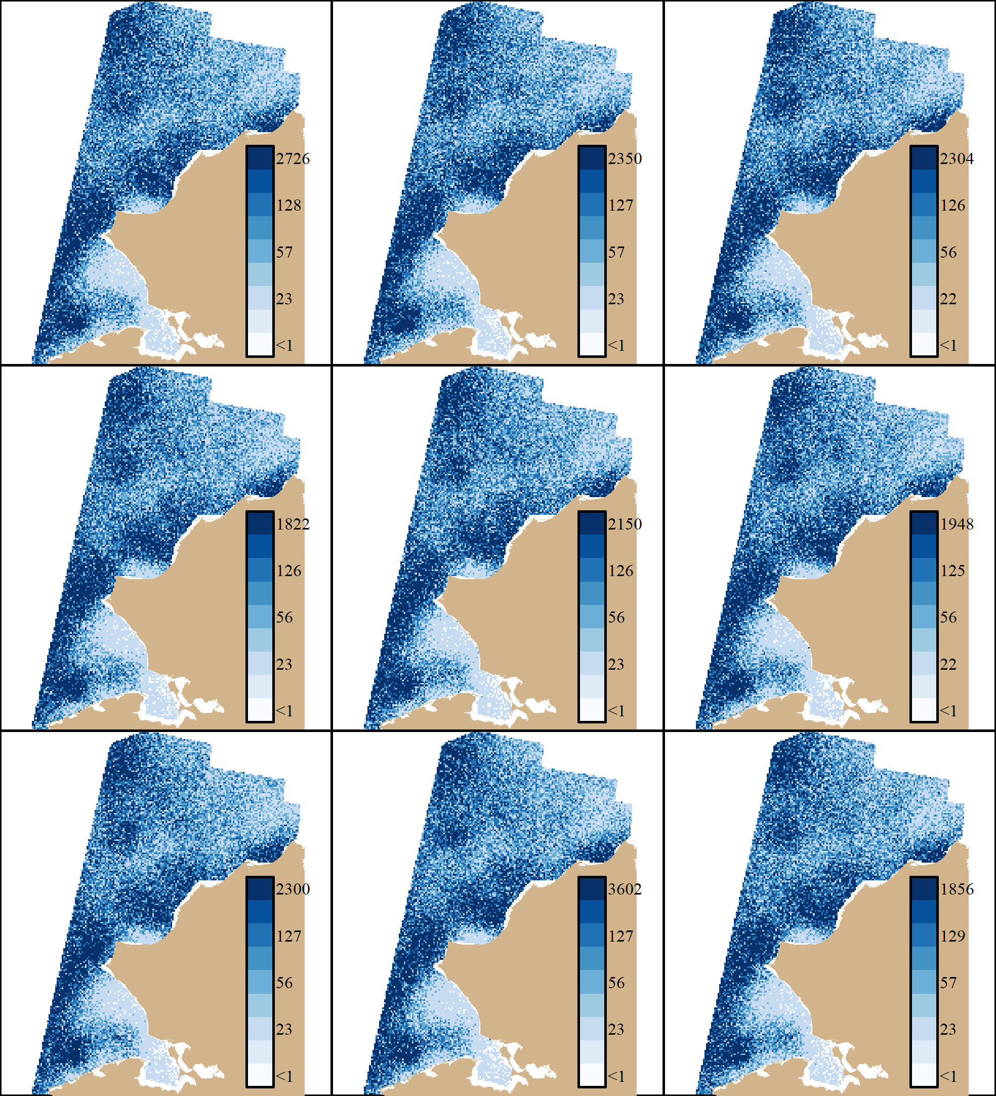
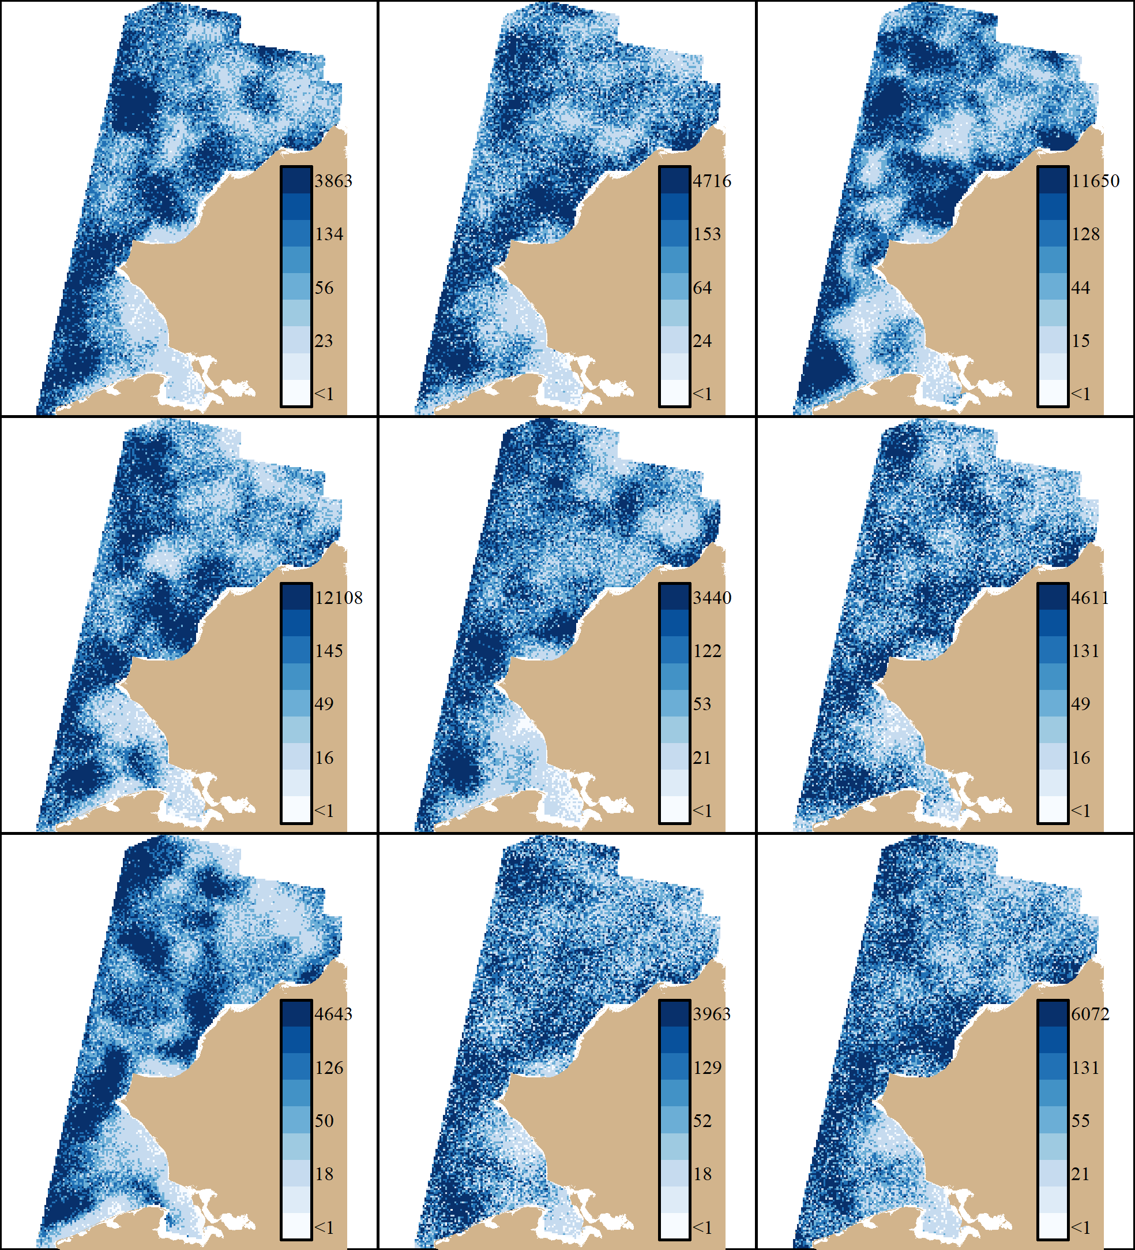
Arctic cod
Sim 1 (Measurement Error)
Sim 3 (Random and Fixed)

Slide 12
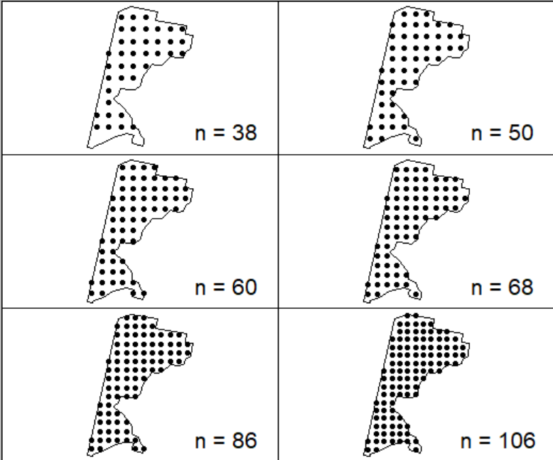
Survey Types:Sampling Intensity Ranges: 40-100 stations
Simple Random Sampling
Systematic Sampling Grid
Stratified Random Sampling
Results from STRS design optimization algorithm
Stratum variables: Latitude and Distance to Shore
3, 4, or 5 total strata

Slide 13
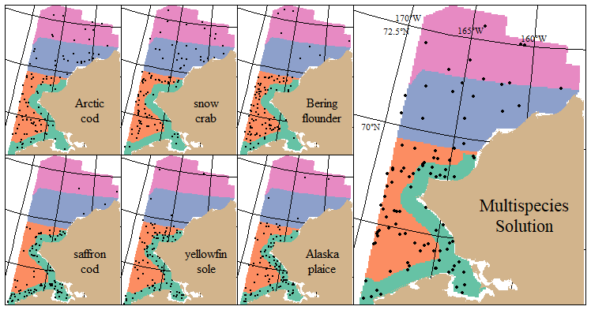
Otter Trawl STRS Solution (4-strata)

Slide 14
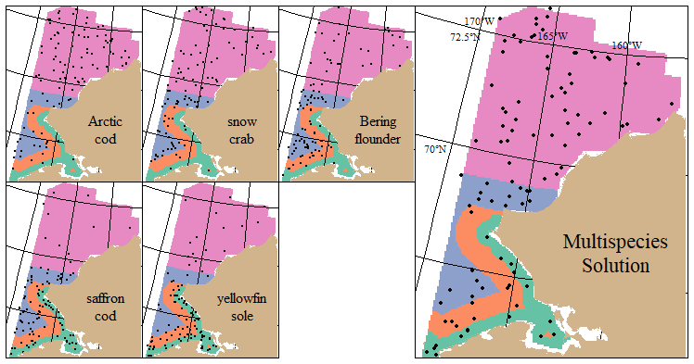
Beam Trawl STRS Solution (4-strata)

Slide 15
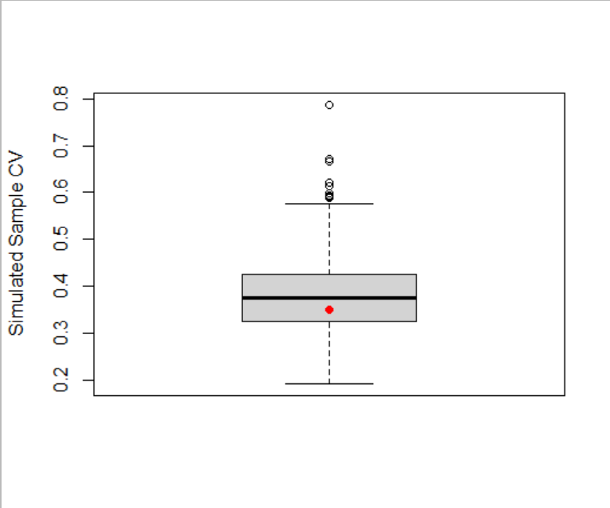
Survey Simulation: Performance
Boxplot of 1000 simulated sample CVs for a given effort level, survey type, and species
Red point: “True CV”, calculated as the sd of the simulated estimated index / true index
RRMSE of CV (not shown): spread of the boxplot and the bias of the sample CV relative to the True CV

Slide 16
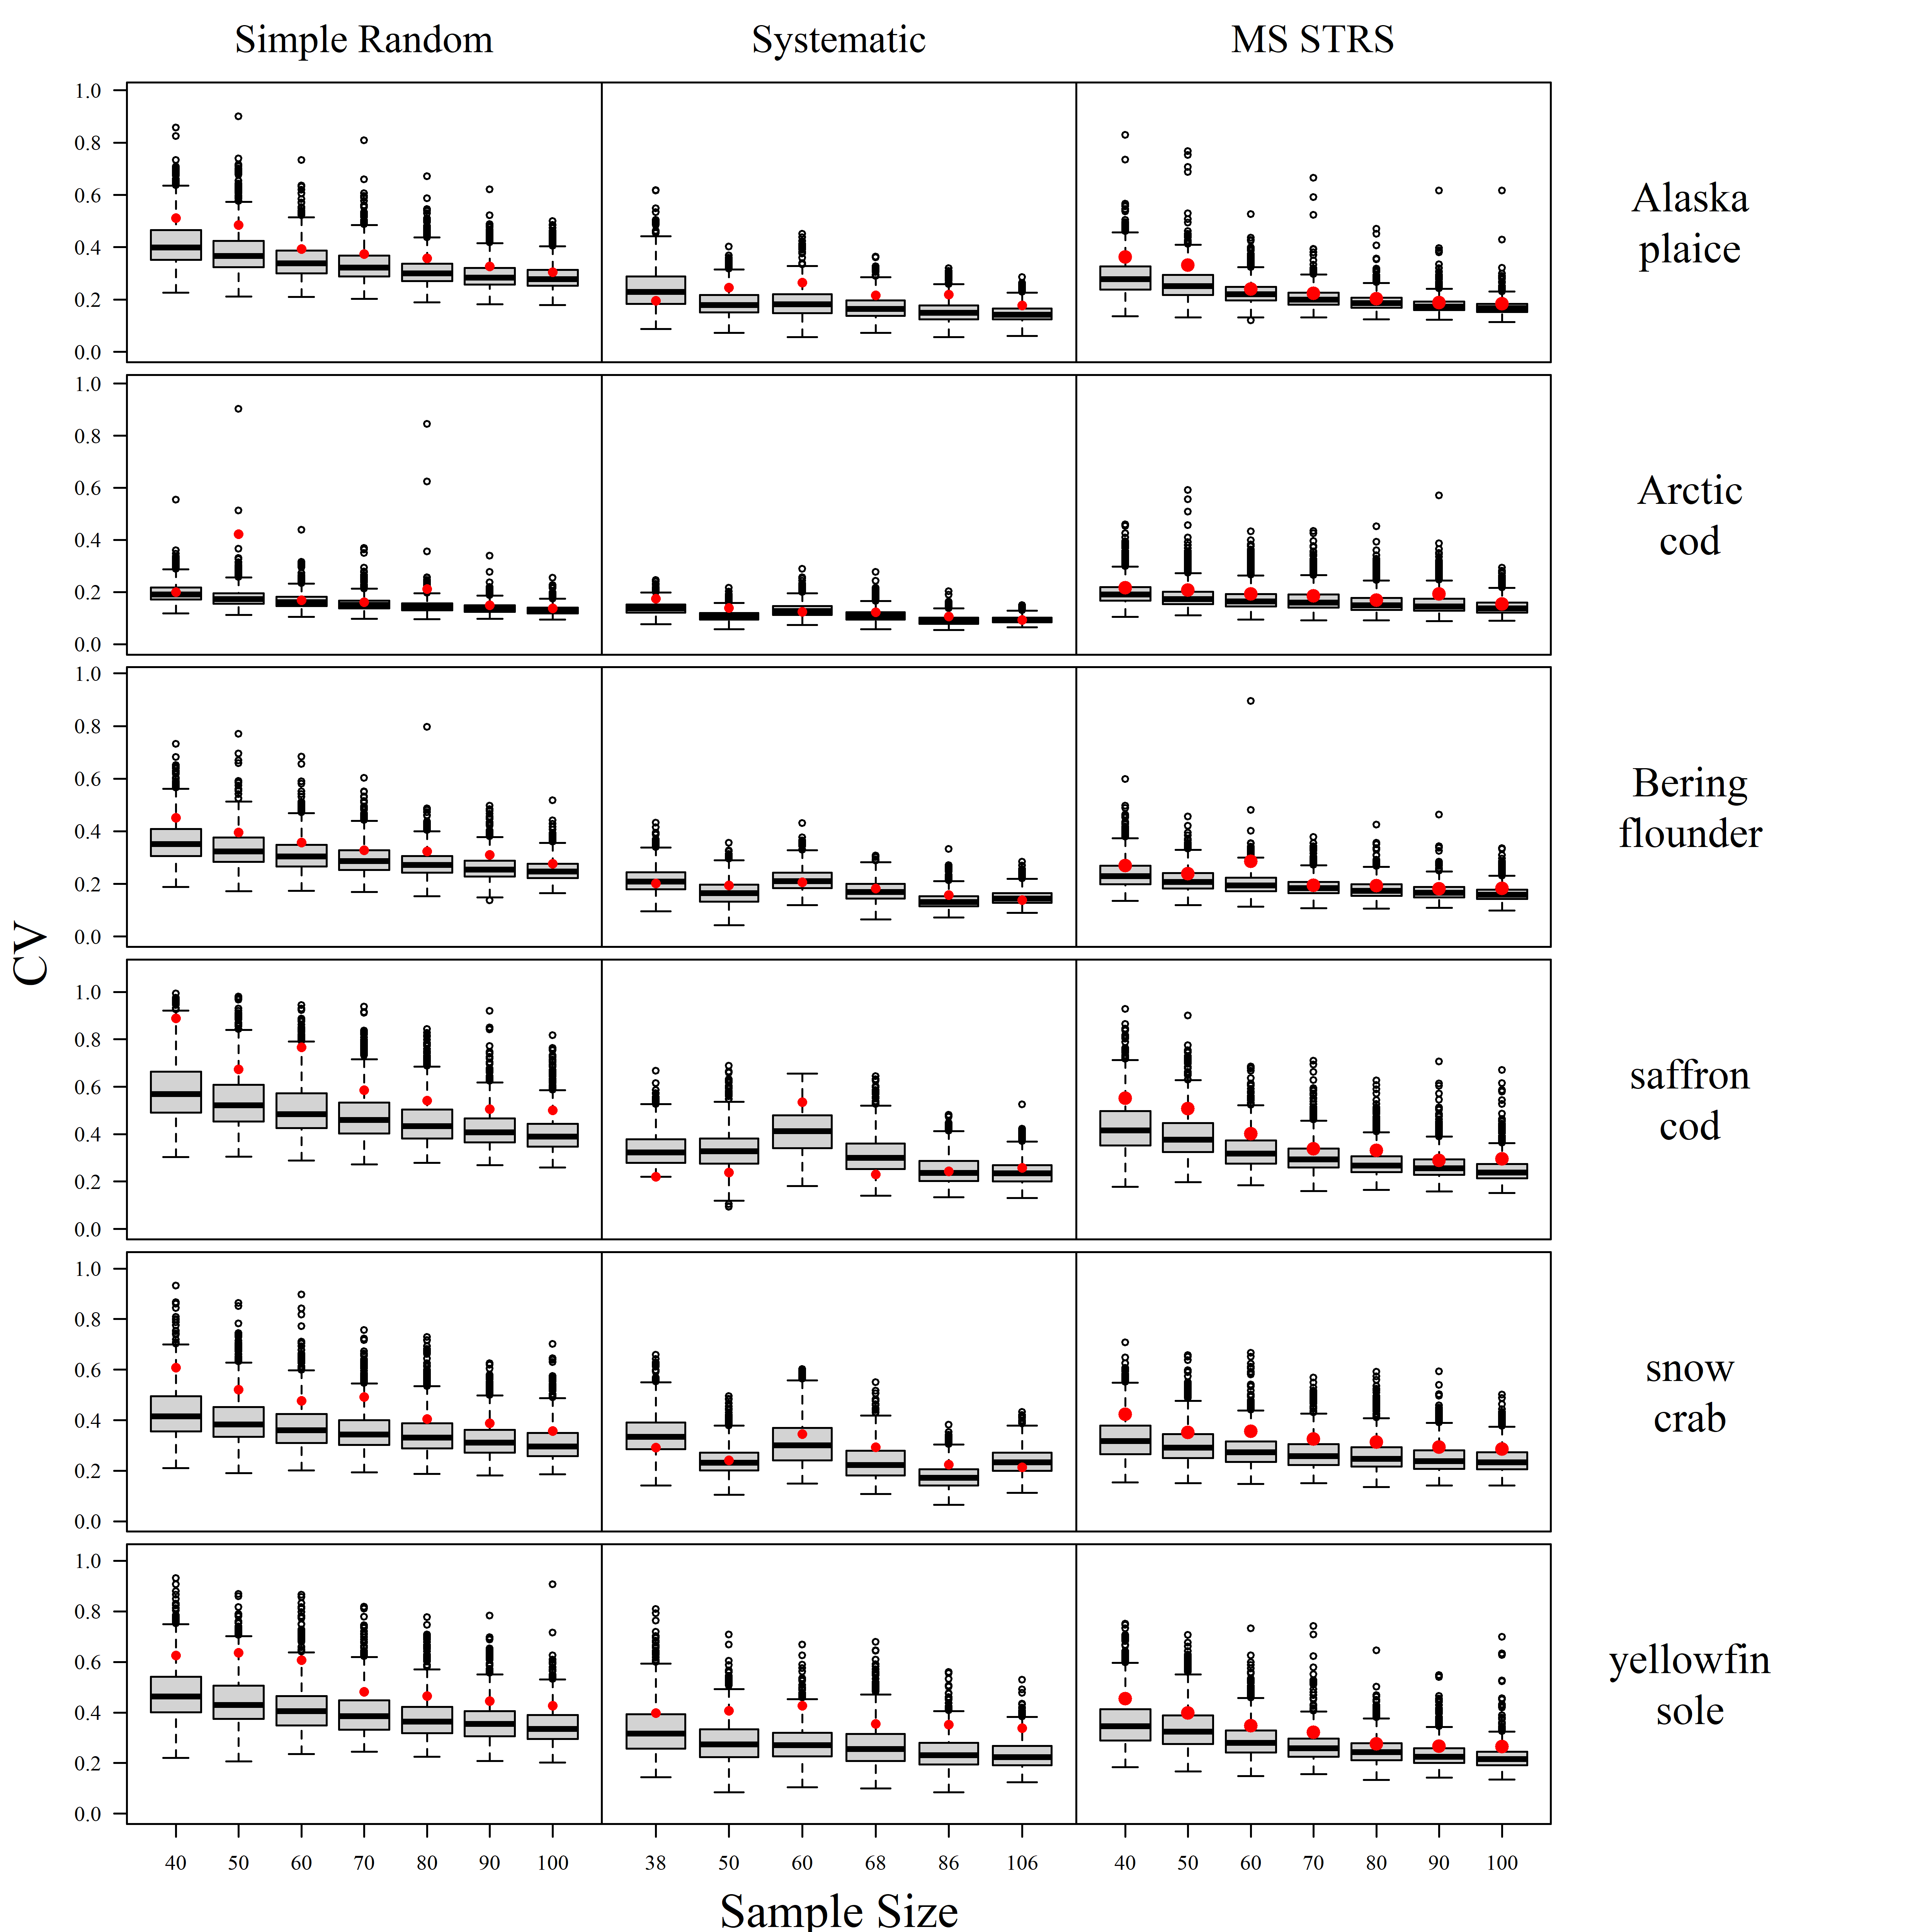
Otter Trawl Survey Performance

Slide 17
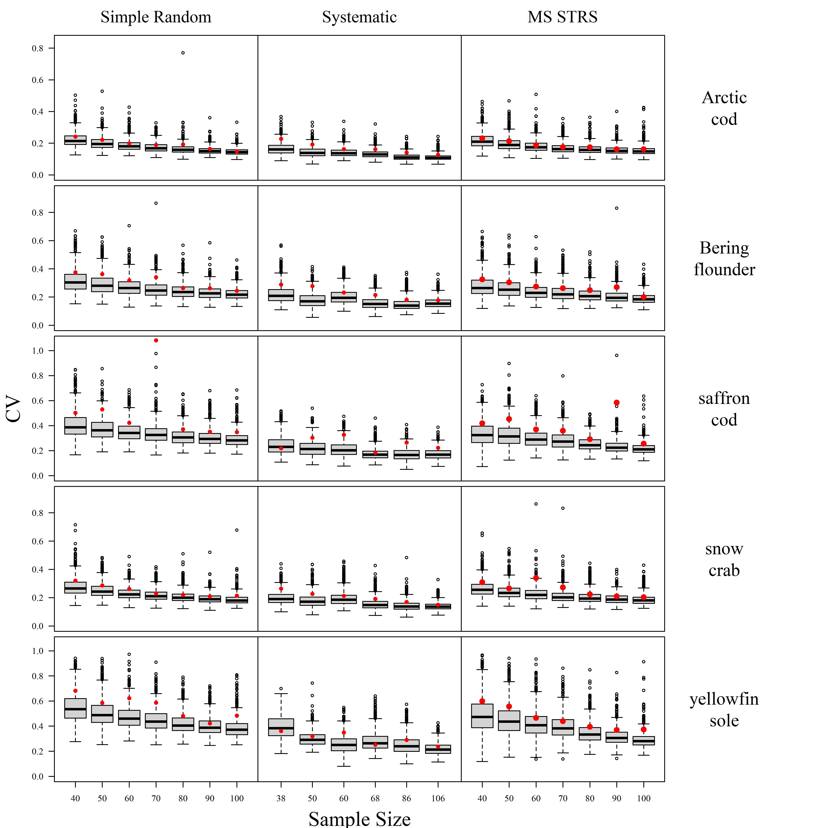
Beam Trawl Survey Performance

